Slide 1
UNIVERSITY OF HARGEISA
Course: Computer Programming I (Java)
Lecture Five
Presented by:
Sahardiid Ahmed Ali

Slide 2
Chapter 4
Control Statements

Slide 3
Learning Objectives
At the end of the lesson student should be able to:-
Define Control Statement
Explain Relational Operators
Explain Logical Operators
Explain Conditional Statement
Simple IF
IF...else(Compound IF)
Nested IF
Explain Selection statement
Switch Case
Explain Loop statements
For Loop
While Loop
Do While Loop

Slide 4
Control Statement
Normally, a program executes statements from first to last.
The first statement is executed, then the second, then the third, and so on, until the program reaches its end and terminates.
Control statements are portions of program code that contain statements within them and, depending on the circumstances, execute these statements in a certain way.
There are typically three kinds: Conditional Statement, Selection Statement and loops Statement.

Slide 5
Control Statements
Explain Conditional Statement
Simple IF
IF...else(Compound IF)
Nested IF
Explain Selection statement
Switch Case
Explain Loop statements
For Loop
While Loop
Do While Loop

Slide 6
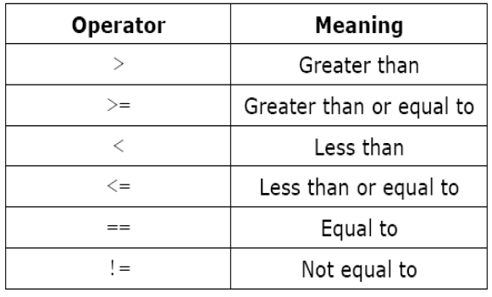
Relational Operators
The relational operators are used to test a relation between two expressions.
Chapter 4

Slide 7
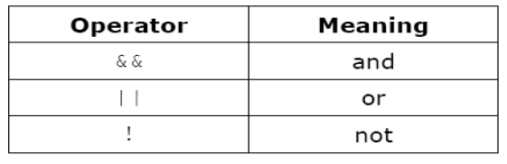
Logical Operators
The logical operators are often used to combine relational expressions into more complicated Boolean expressions
Chapter 4

Slide 8
Simple IF Statement
The if statement determines whether a code should be executed based on the specified condition.
Syntax:
if (condition=True) {
Execute True Statement 1; //executed if condition is true
}
Chapter 4

Slide 9
Example : Simple IF Statement
package javaapplication24;
import java.util.Scanner;
public class JavaApplication24 {
public static void main(String[] args) {
int grade;
System.out.println("Enter your Grade:");
Scanner x = new Scanner(System.in);
grade=x.nextInt();
if (grade>=50){
System.out.println("Pass");
}
}
}

Slide 10
IF..Else Statement (Compound IF)
In this statement, if the condition specified is true, the if block is executed. Otherwise, the else block is executed.
Syntax:
if (Condition=True) {
Excute True Statement ; //Execute True Statement
else
Excute False Statement; // Execute False Statement
}

Slide 11
Example : IF..Else Statement
package javaapplication24;
import java.util.Scanner;
public class JavaApplication24 {
public static void main(String[] args) {
int grade;
System.out.println("Enter your Grade:");
Scanner x = new Scanner(System.in);
grade=x.nextInt();
if (grade>=50){
System.out.println("Pass");
}
else{
System.out.println("Fail");
}
}
}

Slide 12
Nested IF Statement
An if present inside an if block is known as a nested if block. It is similar to an if..else statement, except they are defined inside another if..else statement.

Slide 13
Syntax
if (condition1) {
Statement 1; //executed if first condition is true
Else if (condition2) {
Statement 2; //executed if second condition is true
}
else {
Statement 3; //executed if second condition is false
}
}

Slide 14
Example : Nested IF Statement
package javaapplication24;
import java.util.Scanner;
public class JavaApplication24 {
public static void main(String[] args) {
int grade;
System.out.println("Enter your Grade:");
Scanner x = new Scanner(System.in);
grade=x.nextInt();
if (grade>=85){
System.out.println("A");
}
else if(grade>=75){
System.out.println("B");
}
else if(grade>=65){
System.out.println("C");
}
else if(grade>=50){
System.out.println("D");
}
else{
System.out.println("F");
}
}
}

Slide 15

Any Question??

Slide 16
Thanks

